Slide 1

Click Through Rate Prediction
Group No. 16
Author Name: Amitesh Tripathi & Sayali Lad

Slide 2
Table of Contents
Project Overview
Problem Setting
Problem Definition
Data Sources
Data Description
Exploratory Data Analysis
Model Exploration
Model Selection
Model Evaluation
Project Results
Key Findings
Potential Improvements

Slide 3
Project Overview
27 Jan.
Initial Project Proposal
3 Feb.
Final Project Proposal
17 Feb.
Data Collection, visualization, exploration, processing
3 Mar.
Exploration of Candidate Data mining and Selecting the Final Model
24 Mar.
Model Performance Evaluation and Interpretation
7 Apr.
Draft of Project Report
16 Apr.
Draft of Project presentation and Recording
22 Apr.
Final Project Report, Code Submission, Presentation Slides and Recording

Slide 4
Problem Setting
Problem Setting: Improve advertising effectiveness for a client using historical data to predict the likelihood of users clicking on specific products/campaigns
Goal: Optimize marketing resources and increase ROI
Solution: Use data mining techniques to analyze, build predictive models, and evaluate performance

Slide 5
Problem Definition
Predict if a user will click on an ad or not, based on available features
This will be done by analyzing the user's view log, ad impression, and user data to determine the probability of a click in the next 7 days.
Our objective is to develop a robust model with high accuracy and low error
Evaluation metrics considered for measuring the performance of the model are Accuracy, Precision, Recall, F1-score, and AUC-ROC

Slide 6
Data Sources
Website Link : https://www.kaggle.com/datasets/arashnic/ctr-in-advertisement
Topic : Click Through Rate prediction
Dataset Owner : Kaggle
License : https://creativecommons.org/publicdomain/zero/1.0/

Slide 7
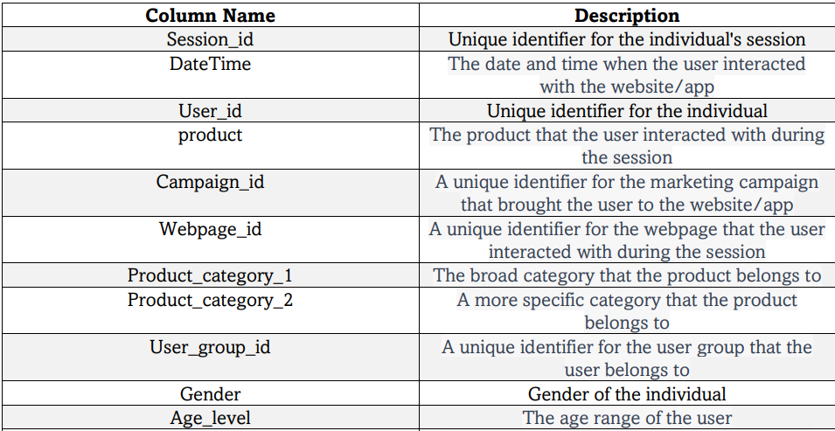
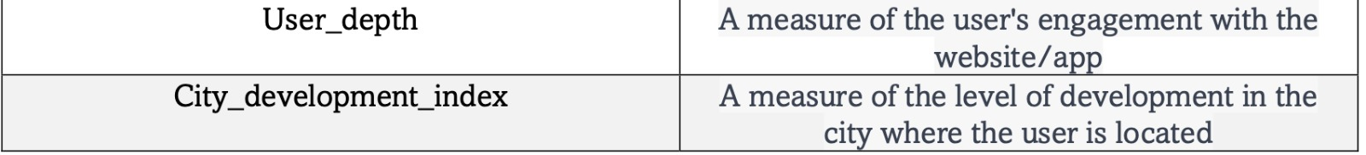
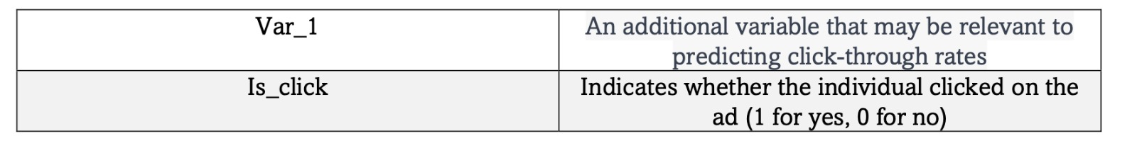
Data Description
Rows | Columns
4,63,291 | 15
The chosen columns were carefully selected based on their relevance to the goals of the analysis, ensuring the quality and consistency of the final dataset

Slide 8
Data Pre-processing & Feature Selection
The dataset underwent a data cleaning process to handle missing or null values.
2.In order to prevent any potential bias or skewed results, the feature related to product category 2 was removed from the dataset due to the presence of null values.
3.The DateTime column was transformed using feature engineering techniques to better suit the research objectives, allowing for more accurate and meaningful analysis of user behavior.
4.To enable analysis of categorical variables, label encoding was applied to the gender and product columns to transform these variables into numerical values.
5.The overall click-through rate of the advertisements was analyzed by deriving an average click-through rate column, which provided valuable insights and informed decision making.

Slide 9
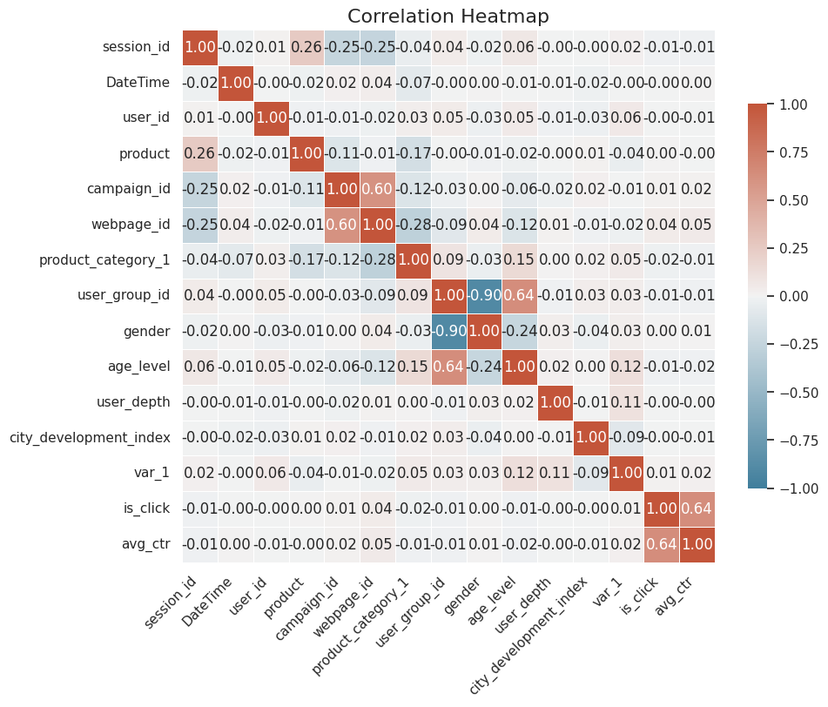
Exploratory Data Analysis

Slide 10
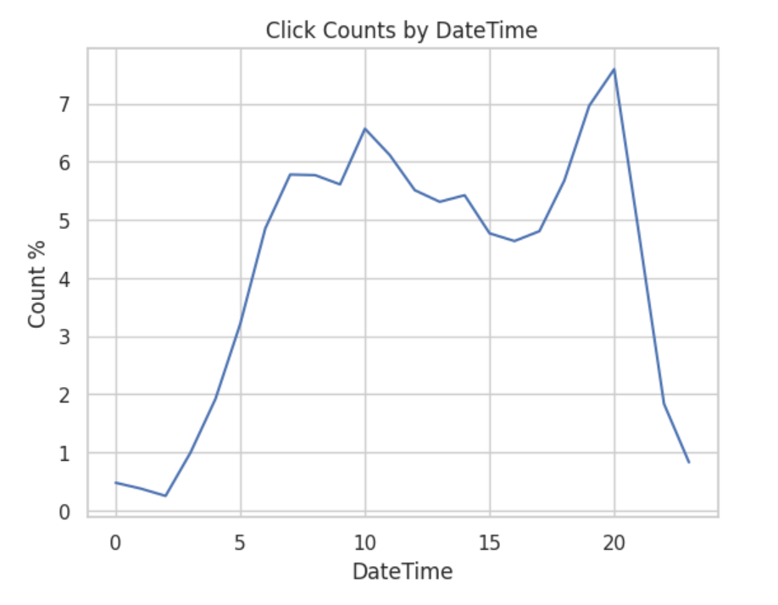
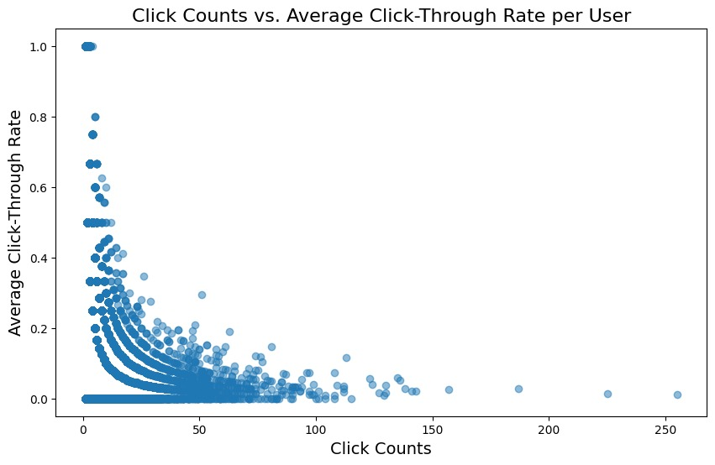
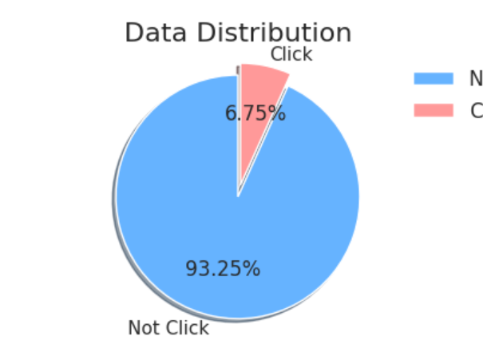
Exploratory Data Analysis

Slide 11
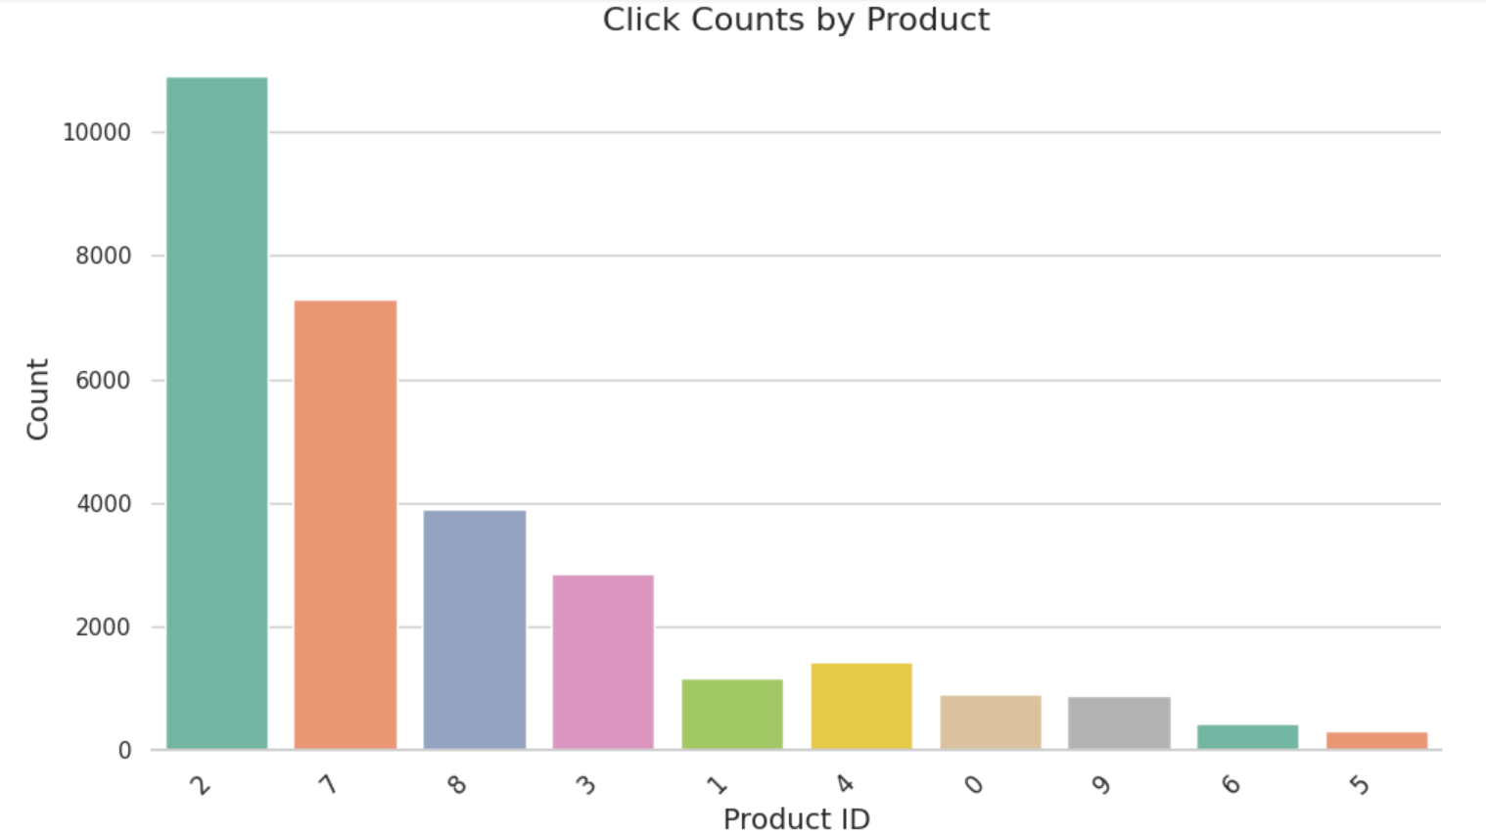
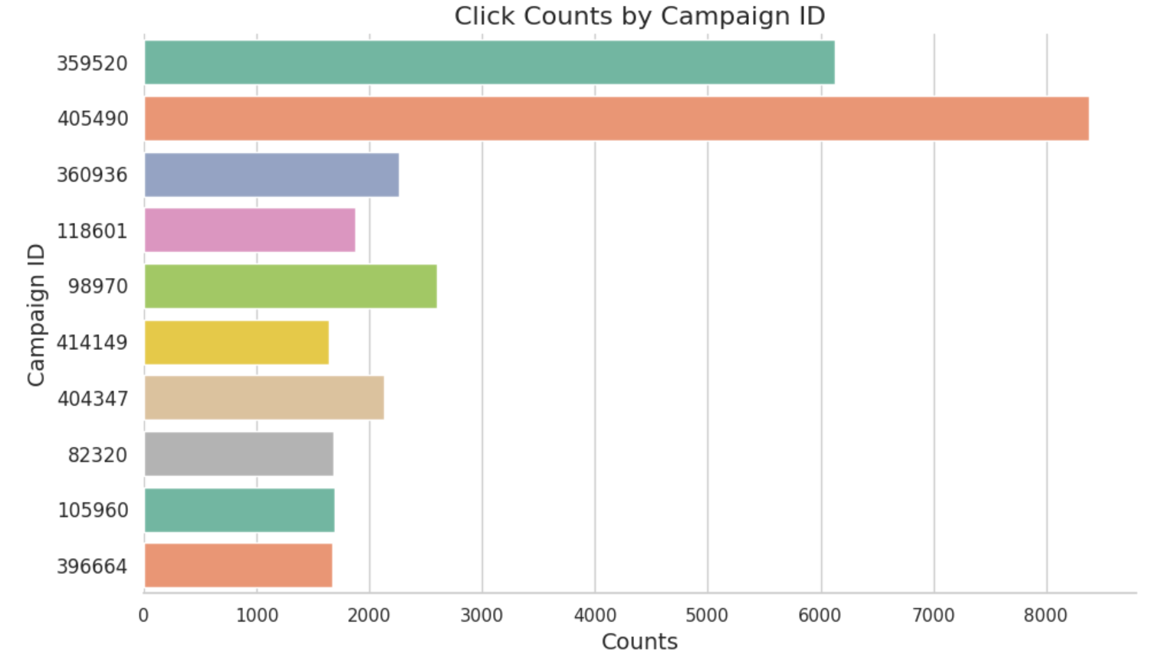
Exploratory Data Analysis

Slide 12
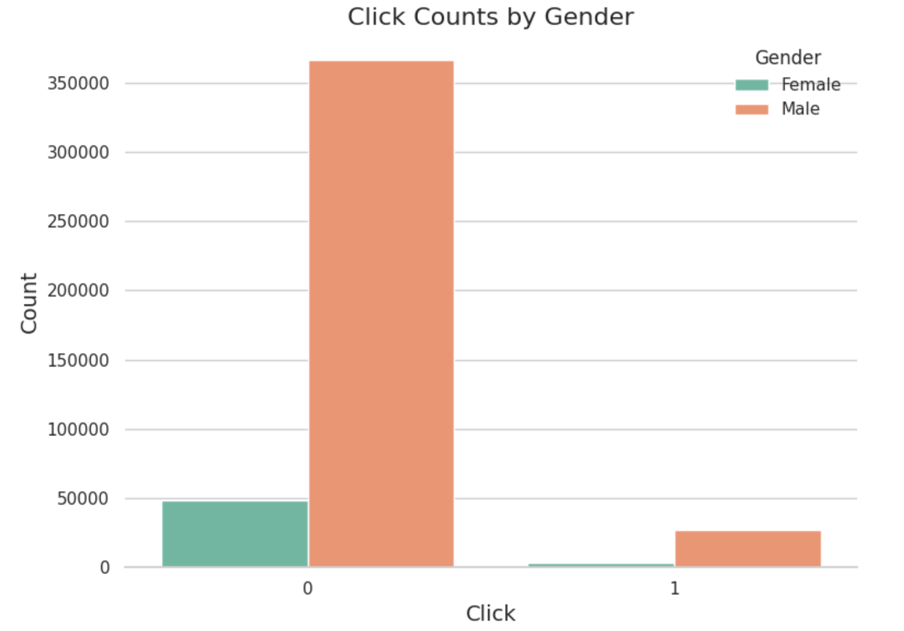
Exploratory Data Analysis

Slide 13
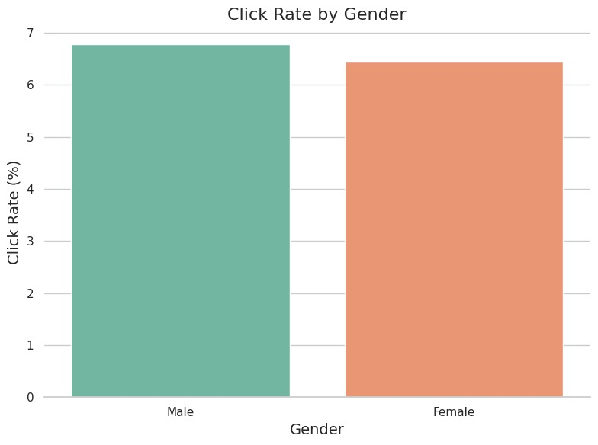
Exploratory Data Analysis

Slide 14
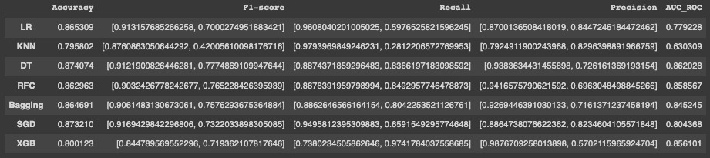
Model Exploration
We evaluated several data mining models for predicting the click-through rate. These models include:
Logistic Regression Classifier
K-Nearest Neighbors (KNN) Classifier
Decision Tree Classifier
Random Forest Classifier
Bagging Classifier
Stochastic Gradient Descent (SGD) Classifier
Gradient Boosting Classifier
Extreme Gradient Boosting (XGBoost) Classifier

Slide 15
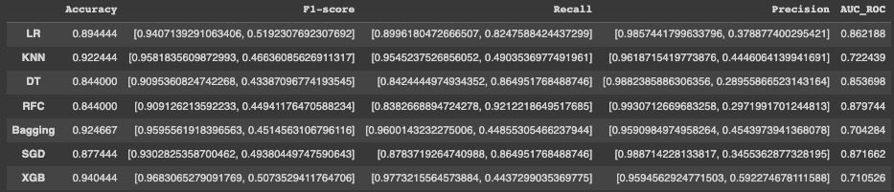
Model Exploration
We evaluated several data mining models for predicting the click-through rate. These models include:
Logistic Regression Classifier
K-Nearest Neighbors (KNN) Classifier
Decision Tree Classifier
Random Forest Classifier
Bagging Classifier
Stochastic Gradient Descent (SGD) Classifier
Gradient Boosting Classifier
Extreme Gradient Boosting (XGBoost) Classifier

Slide 16
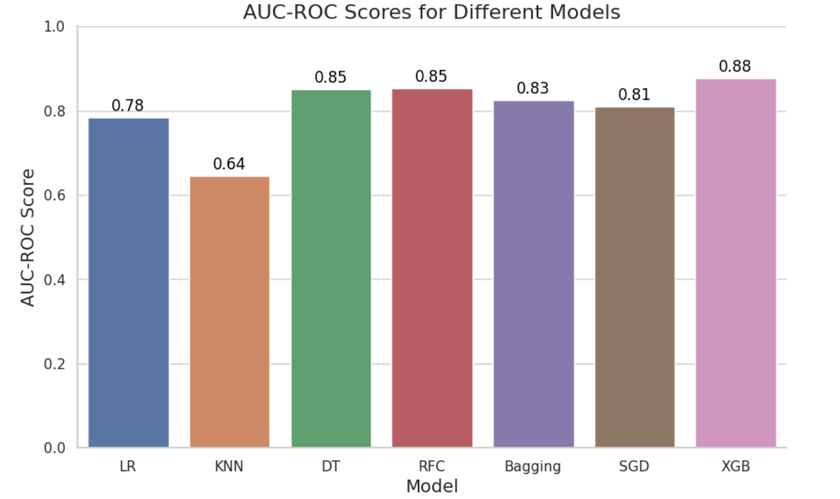
Model Selection
We also found that the Voting Classifier 1 combining Decision Tree, Random Forest, and Extreme Gradient Boosting classifiers displayed greater accuracy than the others
Decision Tree Classifier: A flowchart-like model of decisions used to predict the class of input.
Random Forest Classifier: Combines multiple decision trees to improve performance and reduce overfitting.
Extreme Gradient Boosting Classifier: Ensemble algorithm that combines weak models to create a strong model. Known for its speed and performance.

Slide 17
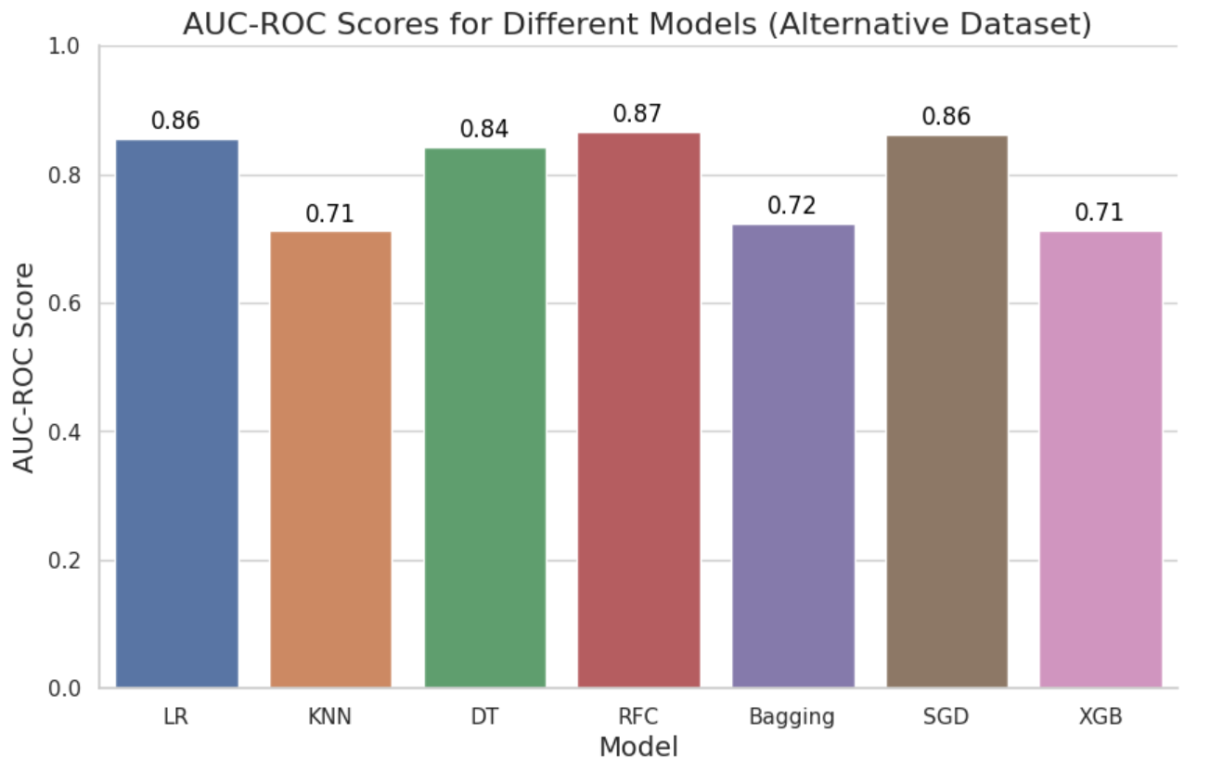
Model Selection
We also found that the Voting Classifier 2 combining Logistic Regression, Random Forest, and Stochastic Gradient Descent (SGD) classifiers displayed greater accuracy than the others
Logistic Regression (LR) is a linear classification model that is easy to interpret and computationally efficient. It is particularly effective for binary classification problems such as predicting click-through rates.
Random Forest Classifier: Combines multiple decision trees to improve performance and reduce overfitting.
Stochastic Gradient Descent (SGD) is a popular optimization algorithm that can handle large datasets with high dimensionality.

Slide 18
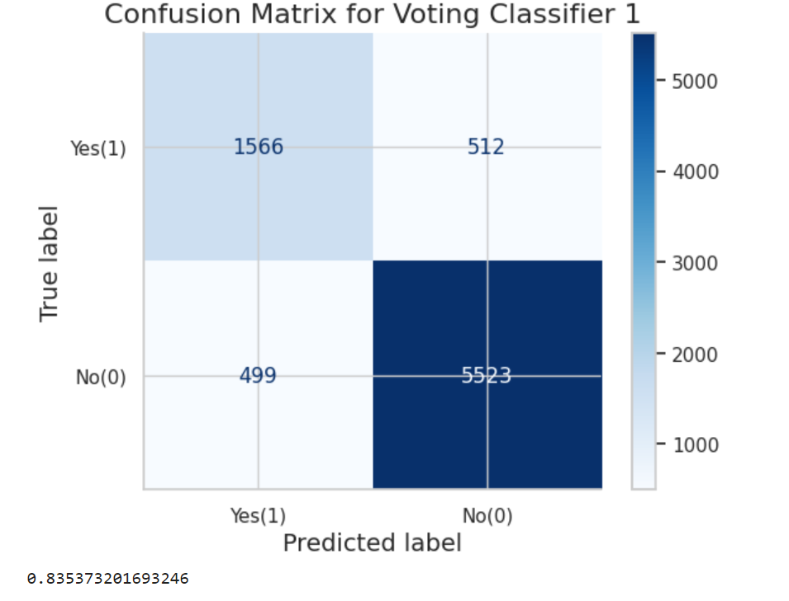
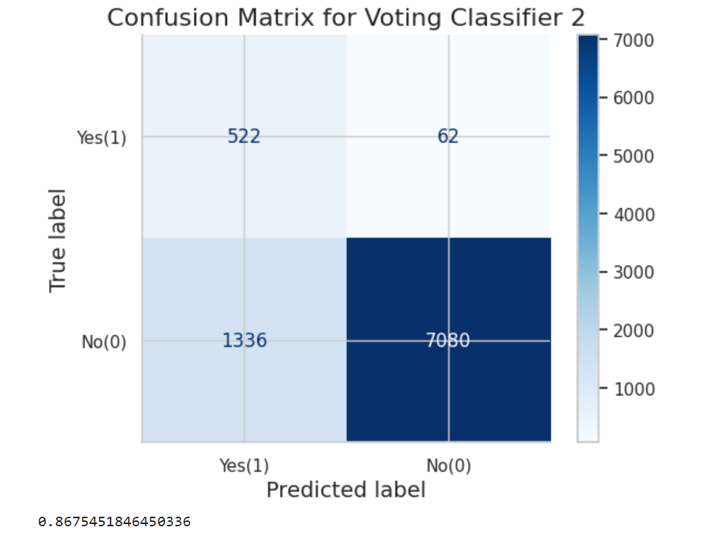
Model Evaluation

Slide 19
Project Results
The project's primary goal is to predict click-through rates (CTR) for online advertisements by creating and deploying a classification model.
The dataset includes features such as user_id, campaign_id, product, and gender, which are utilized to predict whether a user will click on an ad or not.
You have performed a detailed exploratory data analysis to understand the relationships between the features and the target variable, 'is_click.’
The visualizations and findings provide insights into the distribution of clicks across different products, campaigns, and user demographics.
The data preprocessing techniques include sampling, handling imbalanced data using SMOTE, and feature scaling using StandardScaler.
Several classification models, such as Logistic Regression, Random Forest, and Gradient Boosting, have been trained and compared. A voting classifier, which combines these models, has also been created and evaluated.
The performance of the models is assessed using metrics like accuracy, precision, recall, F1-score, and AUC-ROC score. The voting classifier shows the best performance among the evaluated models.
The class of interest which is ‘is_click’ is to be predicted for the customer who is a potential buyer should not be ignored from the ad campaign has been significantly improved which is evident in the confusion matrix i.e False negative.

Slide 20
Key Findings
When evaluating all advertising campaigns, the click-through rate for a particular advertisement typically ranges from 5 to 7 percent.
The top four most important features in the Logistic Regression model were 'session_id', 'DateTime', 'user_id', 'avg_ctr’. These features have a significant impact on whether a user clicks on an ad, and can help optimize advertising campaigns by creating targeted campaigns that consider these key factors.
While the click counts of males is higher compared to females, the percentage of click-through-rate for both genders is nearly equal.
Product no.2 and 7 receive the most number of click counts, with respect to their campaign IDs 405490 and 359520, respectively.
For the imbalanced dataset, DT, RFC, XGB are top classifiers, whereas for the SMOTE balanced dataset, RFC, SGD, LR are the best performing classifiers.

Slide 21
Potential Improvements
Feature Engineering: More relevant features can be added to the dataset to improve the accuracy of the model.
Deep Learning: Deep learning algorithms such as Convolutional Neural Networks (CNNs) and Recurrent Neural Networks (RNNs) can be used to improve the accuracy of the model.
Online Learning: The model can be continuously updated using new data to improve its accuracy over time.
A/B Testing: A/B testing can be used to compare the performance of different models and determine which model performs the best.

Slide 22

Thank You!

